Slide 1
Wicked problems: Facing the challenge of climate change
CHE-125 Chemistry and the Environment
Guest Lecture, September 19, 2017
Caitlin Spence, Postdoctoral Scholar
Earth and Environmental Systems Institute
The Pennsylvania State University

Slide 2
Learning objectives
Differentiate between climate mitigation and climate adaptation
Think critically about climate adaptation and mitigation strategies
Become familiar with ethical frameworks that may guide climate change decision making
Understand tradeoffs between multiple decision objectives
Be able to describe why and how climate change might affect local-scale land management
Notes:
How many of you feel like you can do some of these things already? Cycle through list and look at a show of hands

Slide 3
Designing a global climate management plan
What are the possible effects of climate change?
Who will be impacted, and how?
Who is mainly responsible?
How much should we invest in adaptation?
How much should we invest in mitigation?
Who should pay?
What would adaptation and mitigation look like?
Notes:
Is this the list of topics you would expect to see in a lesson on cimate change in this class? What fits and what doesn’t? Why?

Slide 4
What are the possible effects of climate change?
Weather
Ecosystems
Society
Notes:
Ask the class and write answers on the board under each category, see whtehter they want a new category, leave it up throughout class

Slide 5
Who will be impacted, and how?
Island nations
Coastal zones
Inland zones
Deserts
Agriculture
Tourism
Developing countries
Developed countries
Past generations
Future generations

Slide 6
Who is mainly responsible?
Past
Present
Future

Slide 7
How much should we invest in adaptation?
Climate adaptation: Actions that reduce vulnerability to the harmful impacts of climate change.
Notes:
ASK THE CLASS: Who can think of an example of climate adaptation?

Slide 8
How much should we invest in mitigation?
Climate Mitigation: Actions that reduce atmospheric GHG concentration and the potential for global climate change
Notes:
ASK THE CLASS: Who can think of an example of a “mitigation”?

Slide 9
What would a comprehensive climate mitigation and adaptation plan look like?
Notes:
Ask the class for input

Slide 10
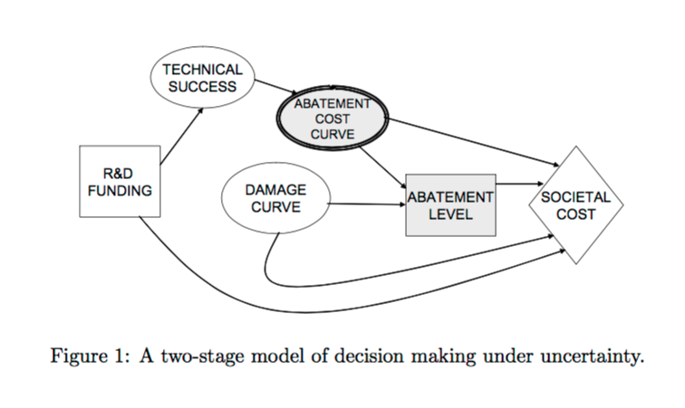
Integrated Assessment Models (IAMs)
Baker et al., 2007
What is the relationship between technology, global and regional economies, and the climate system?
What is the social cost of carbon (SCC)?
On a global scale, what are alternative future societal/climate scenarios?

Slide 11
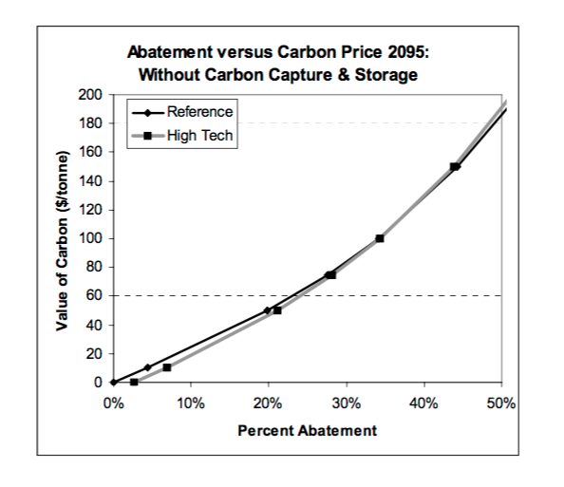
Technological intervention and uncertainty
Baker et al., 2007

Slide 12
Who should pay for climate mitigation and adaptation?
Notes:
S

Slide 13
Ethical frameworks
Consequentialist: What would happen if people behaved this way?
Non-consequentialist: What intentions led to these actions?
Agent-centered: What is the ethical status of these agents?

Slide 14
Consequentialist ethics
Utilitarian: Actions are ethical if they produce the most possible good and the least possible harm.
Egoist: Actions are ethical if they produce the most possible good and least possible harm to oneself.
Common good: Actions are ethical if they are guided by societal consensus and lead to general societal welfare.
Consequentialist decision making
What action would produce the best outcomes?
Notes:
Can anyone sight a potential problem with this school of ethics? What could make these ideas difficult to apply in decision making?
-”The most good for the most people” can systematically exclude minorities, who may repeatedly get the short end of the stick
-Who defines what is “best”?

Slide 15
Non-consequentialist ethics
Duty-based/Kanttian ethics: Actions are ethical if the intention guiding the action is ethical, and if the action could safely become universal.
Rights-based ethics: Actions are ethical if they protect the ethical rights of those affected.
Fairness/Justice: Actions are ethical if they treat all the same without exception.
Divine ethics: Actions are ethical if they serve God’s will.
Non-consequentialist decision making
What is our ethical obligation in this situation?
Notes:
Can anyone see a problem with these schools of ethics? What would make them difficult to apply?
-What is God’s will?
-Treating all people as the same might not work because people aren’t the same and don’t want the same things
-But what is our ethical obligation? Can we all agree on rights?

Slide 16
Agent-centered Ethics
Virtue ethics: A person is ethical if they have acted ethically throughout their life.
Feminist ethics: As above, incorporating concepts of care and focusing on women’s perspectives.
Virtue-based decision making:
What would an ethical and virtuous person do in this situation?

Slide 17
Challenges to ethical decision making
Non-consequentialist decision making
What is our ethical obligation in this situation?
Consequentialist decision making
What action would produce the best outcomes?
Virtue-based decision making:
What would an ethical and virtuous person do in this situation?

Slide 18
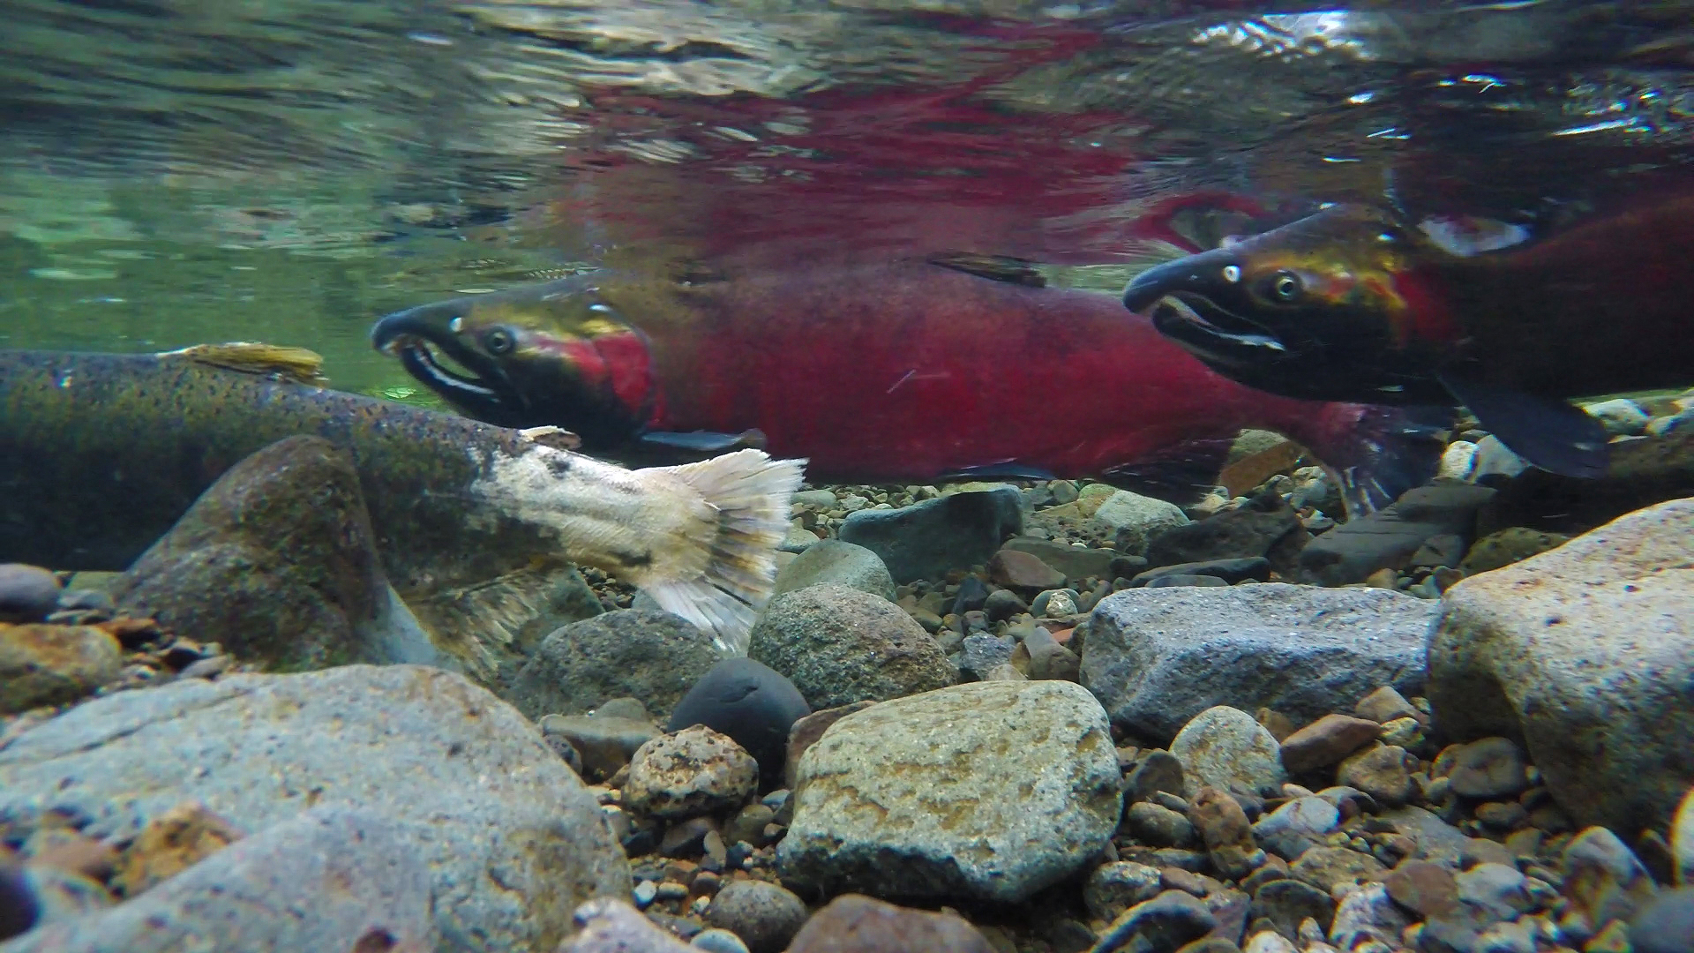
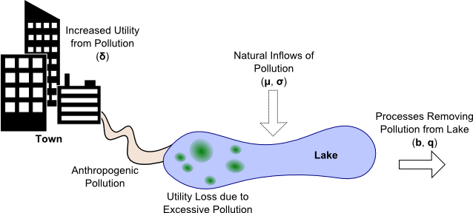
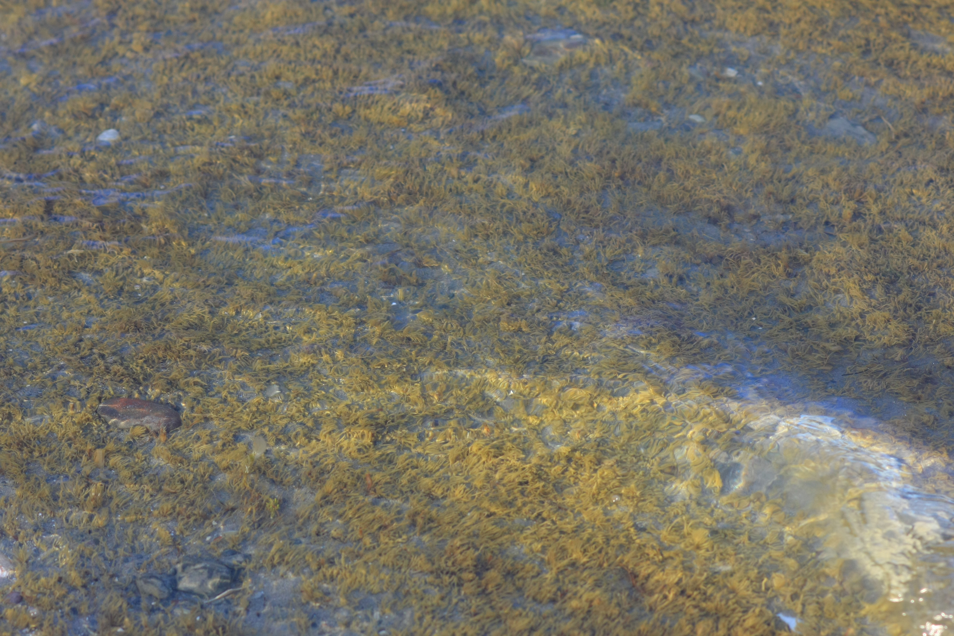

One local-scale example decision: The Lake Problem
Phosphorous concentration below threshold: Healthy lake
Too much phosphorous: Eutrophication
More phosphorous discharge supports economic growth
Figure adapted from Hadka et al., 2015

Slide 19
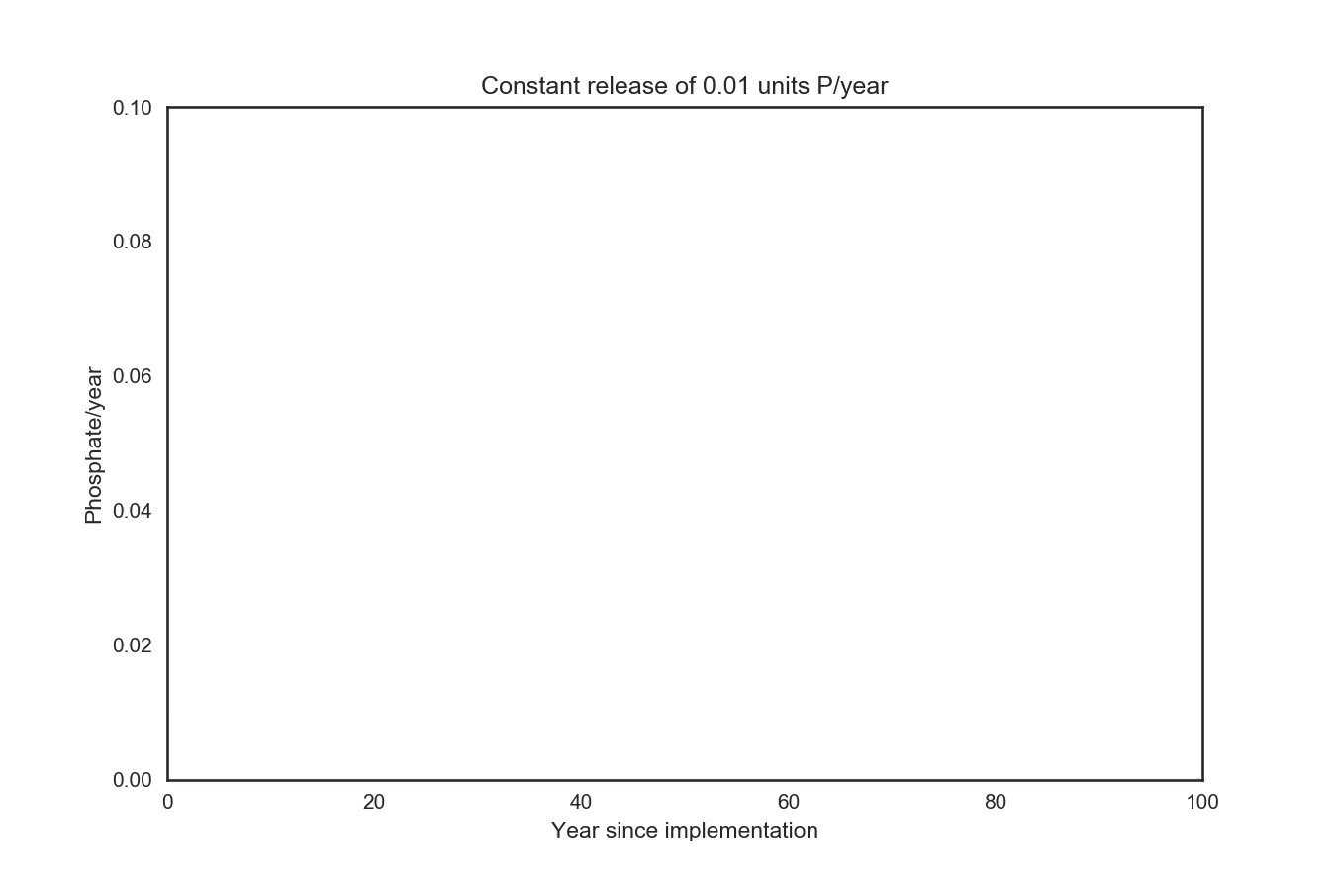
How much discharge per year? Try 0.01 units

Slide 20
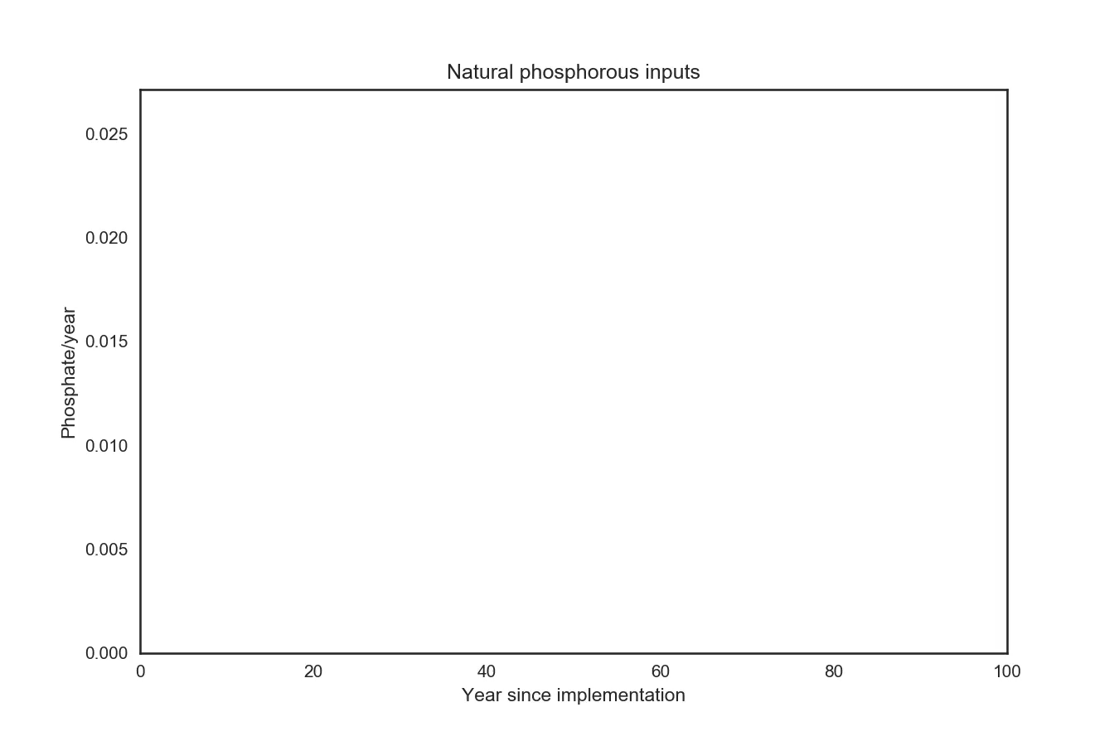
Some phosphate also enters the lake from uncontrollable sources

Slide 21

Total phosphate entering the lake is a combination of factory discharge and natural phosphate

Slide 22
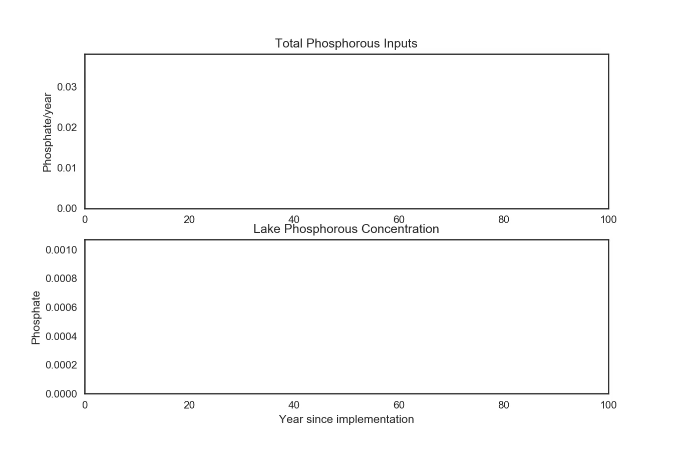
Natural phosphate variability is known, but each year’s value is not known
Notes:
Well-characterized uncertainty!

Slide 23
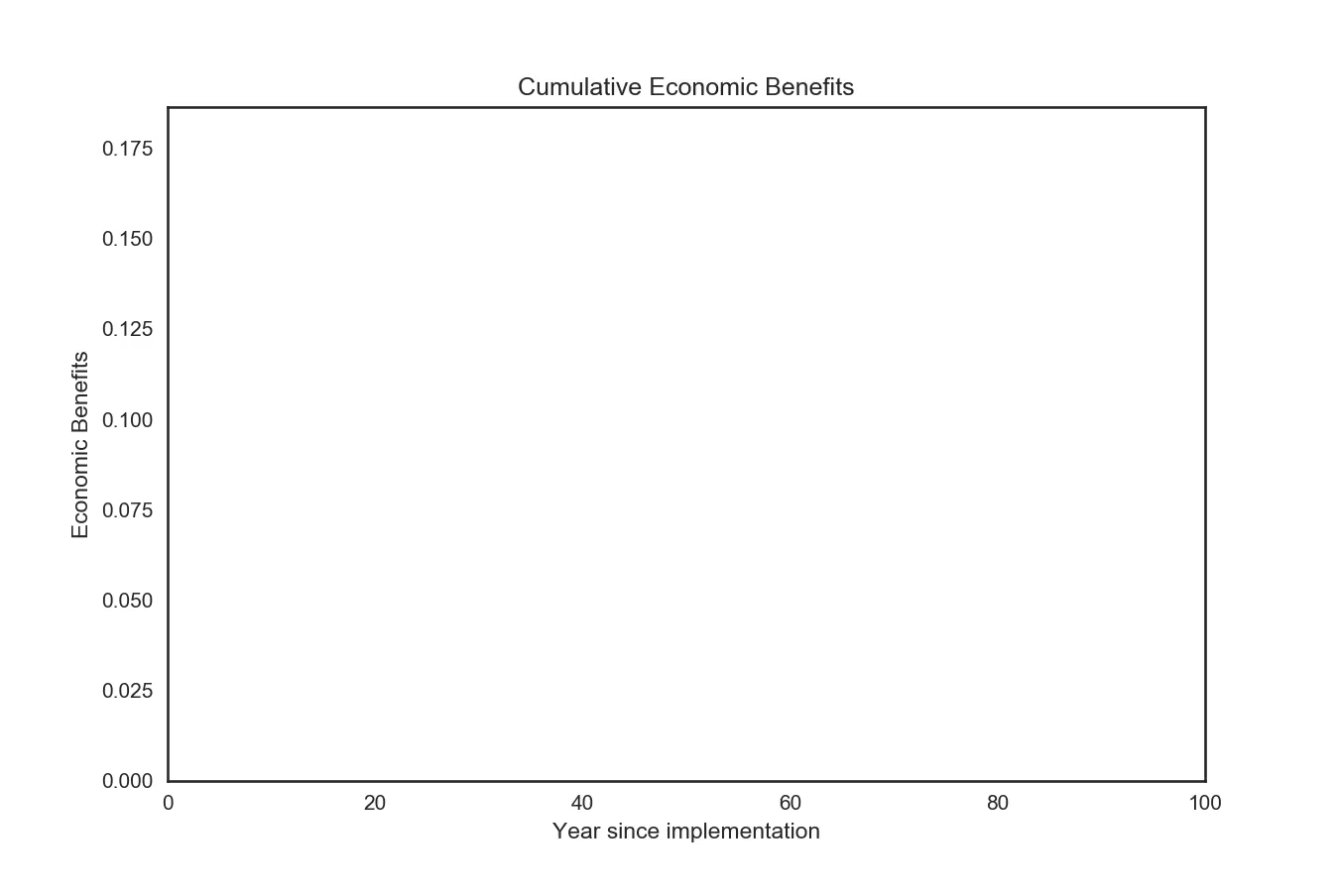
Discharging phosphate from the factory generates economic benefits

Slide 24
Discharging 0.01 P/year does not substantially increase lake phosphorous concentration

Slide 25
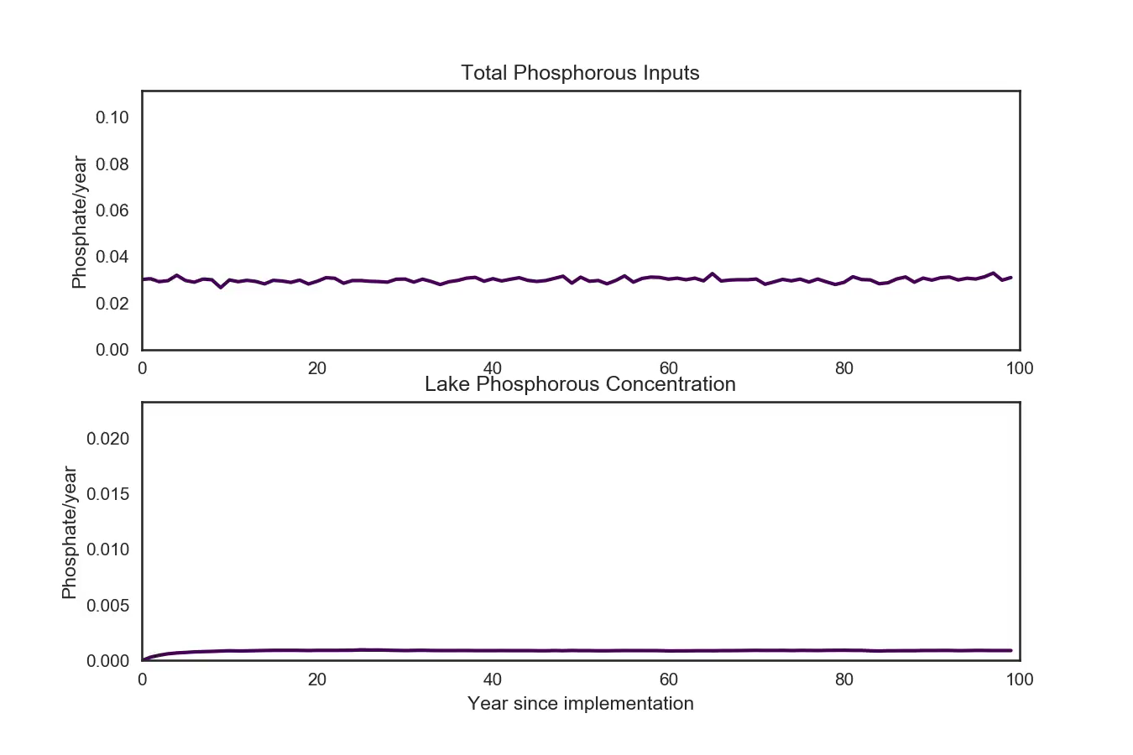
Higher discharge strategies might generate more economic benefits without increasing lake phosphate
Notes:
The higher discharge strategy has a higher risk of crossing the critical threshold.

Slide 26
O’Donoghue, 2016

Slide 27
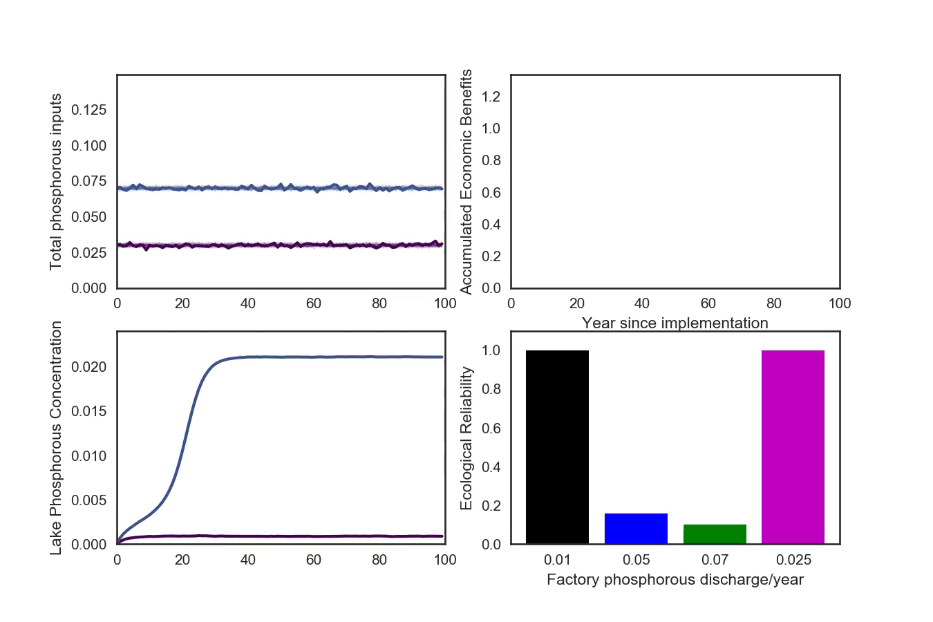
Four alternative strategies fulfill objective differently

Slide 28
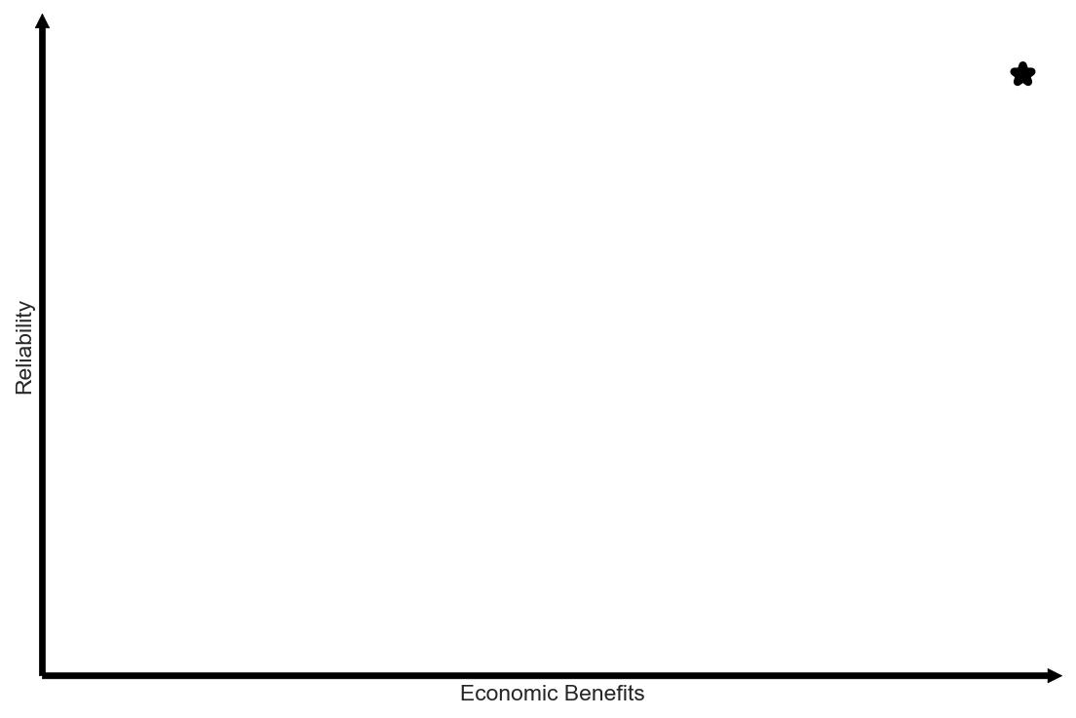
Navigating tradeoffs among multiple objectives

Slide 29
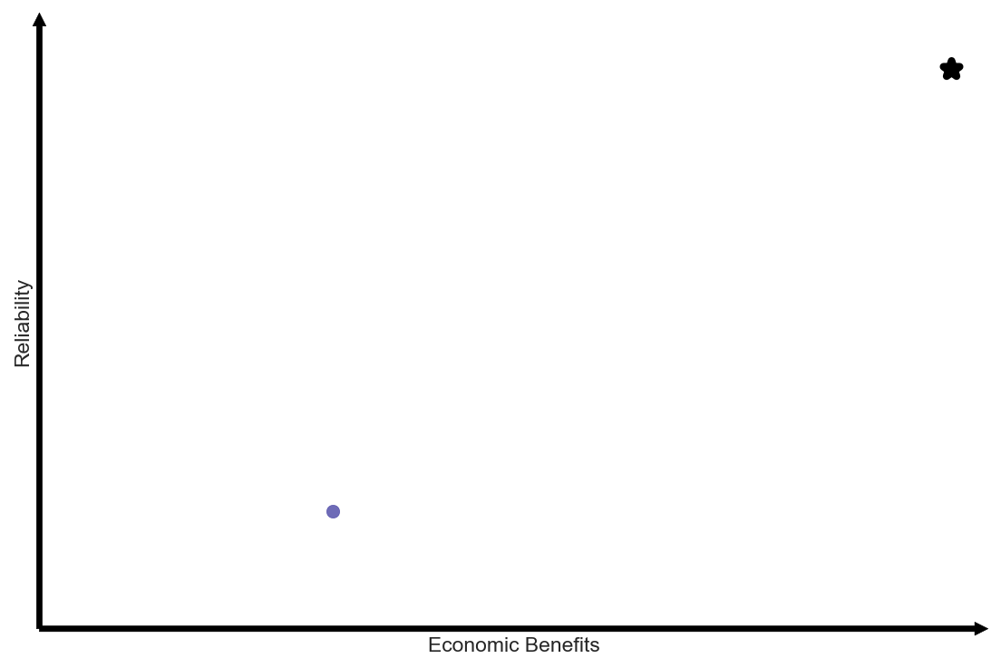
Visualizing tradeoffs: One time-varying discharge strategy

Slide 30
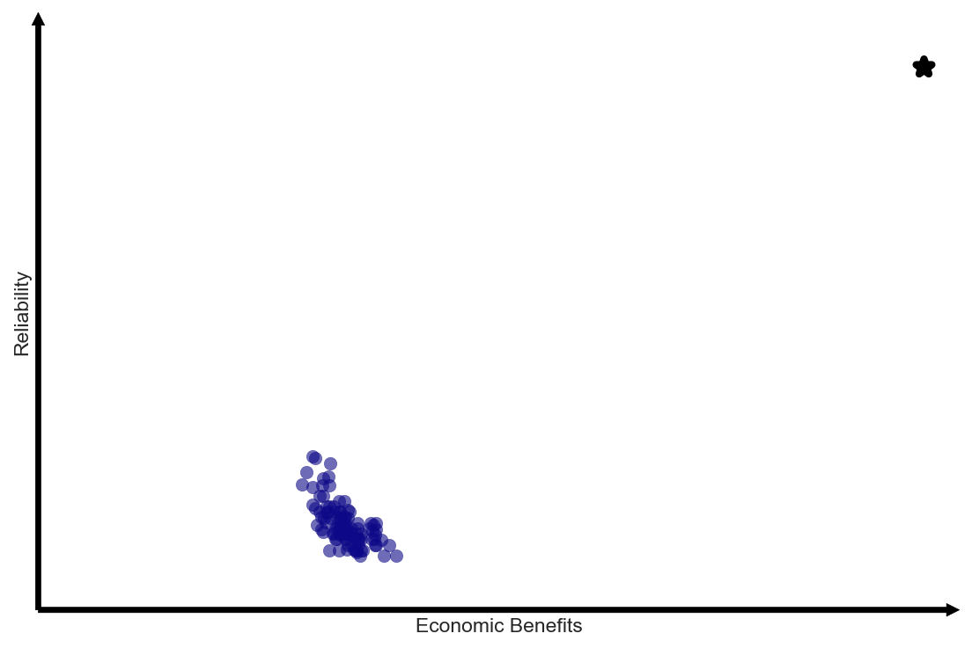
Visualizing tradeoffs: One hundred randomized discharge strategies

Slide 31
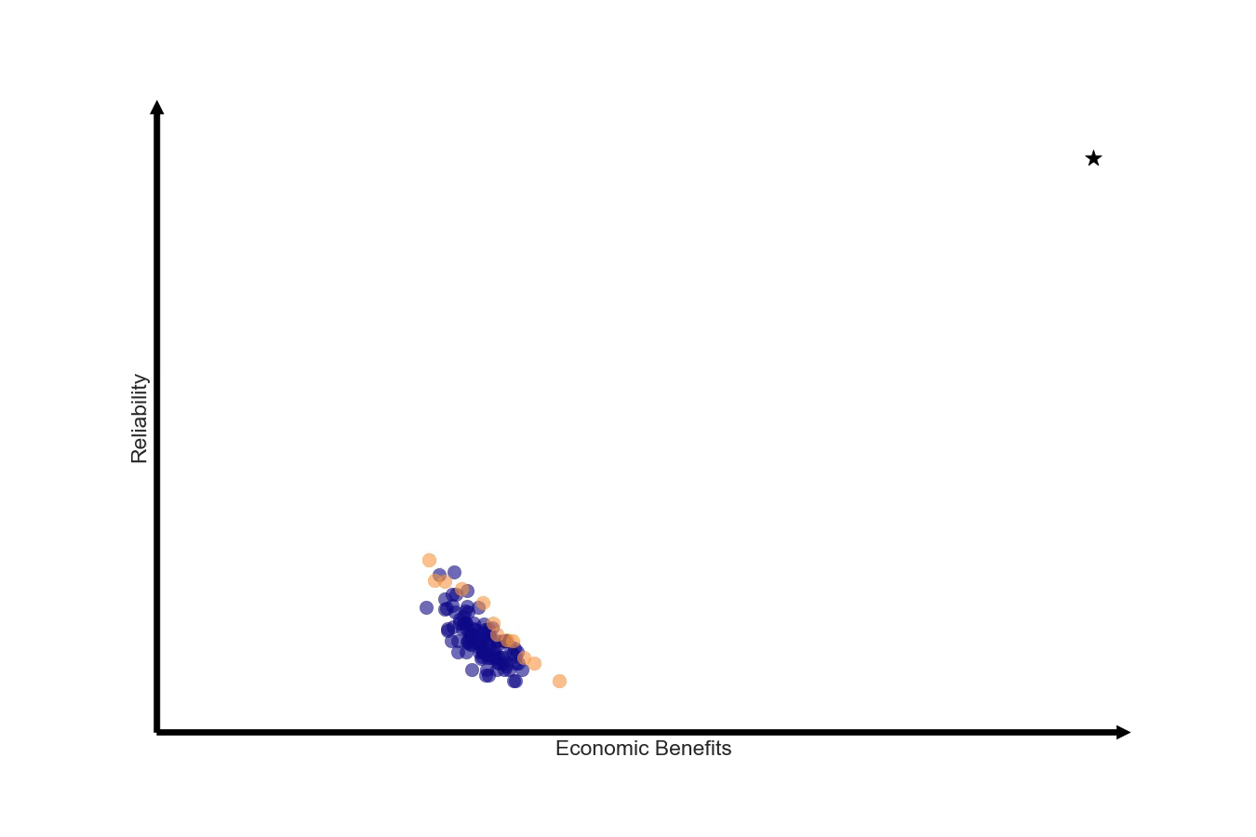
Pareto-dominant strategies cannot be improved without worsening at least one objective’s performance

Slide 32
Multi-Objective Algorithms systematically search for Pareto-dominant discharge strategies

Slide 33
Ecological management under nonstationarity

Slide 34
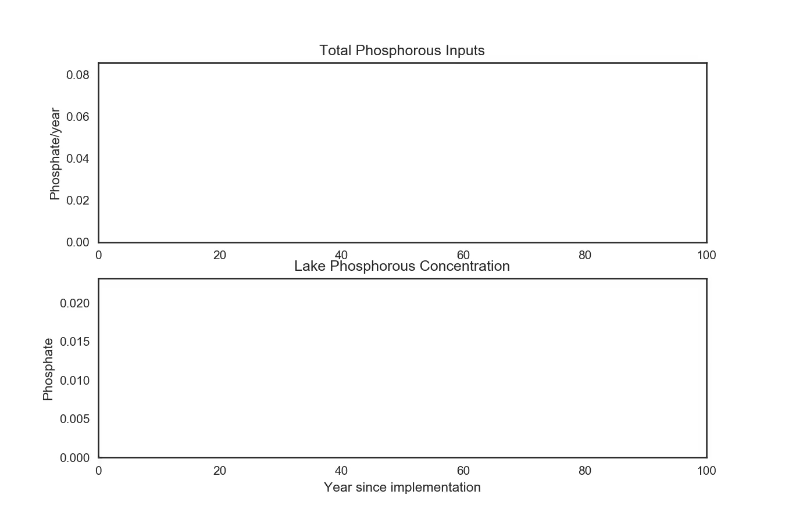
Nonstationary phosphate inputs

Slide 35
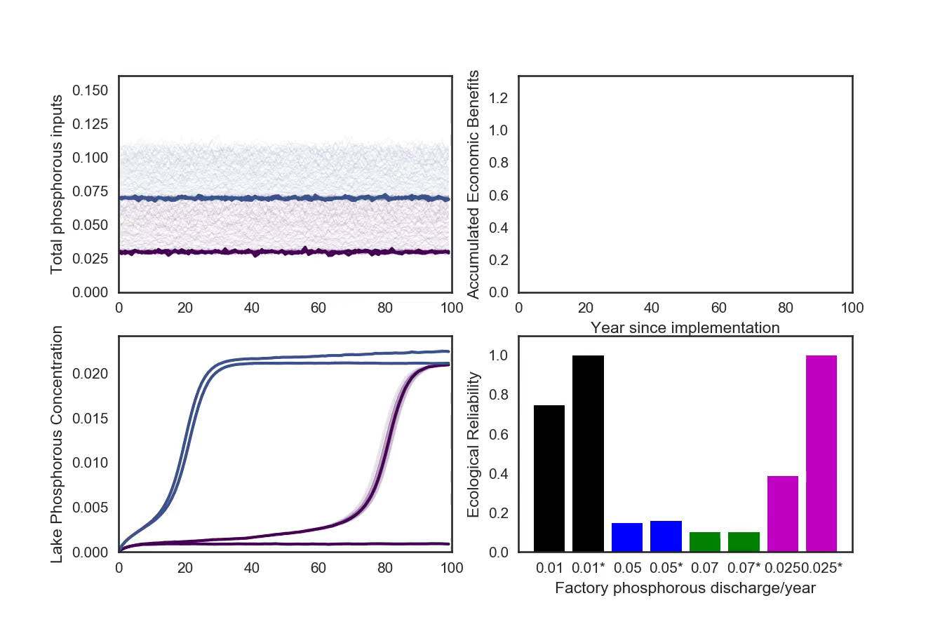
Previous plans aren’t good enough anymore

Slide 36


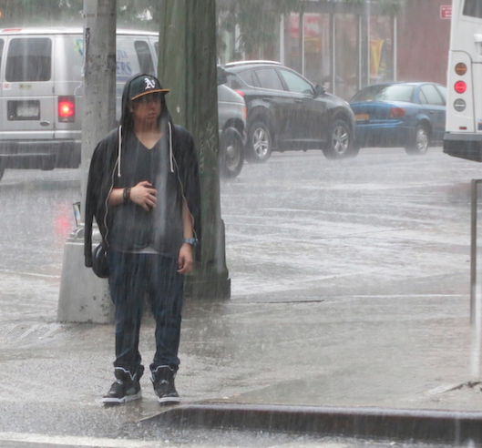
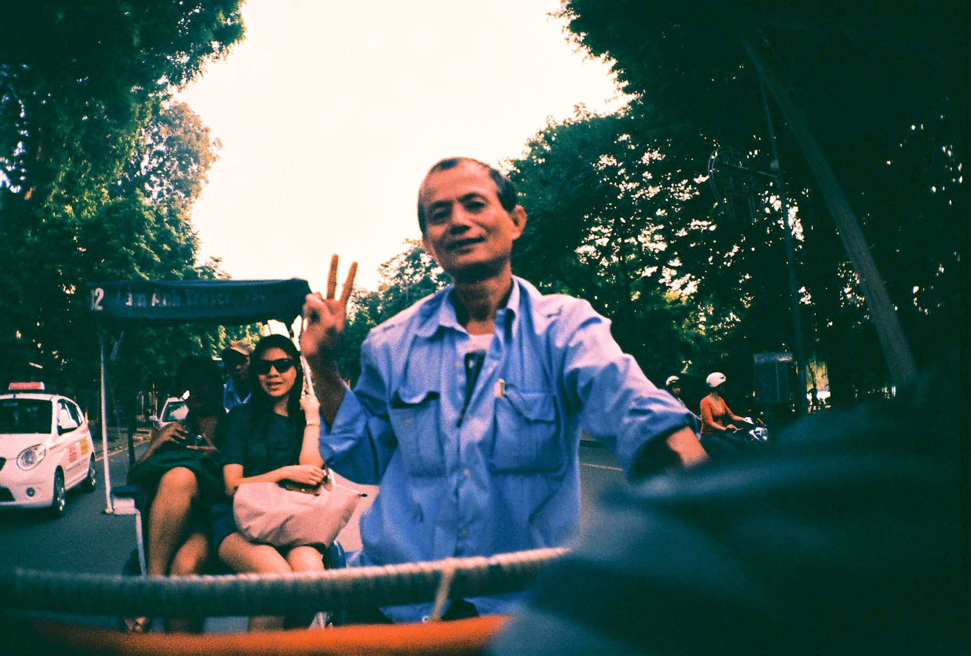
Measuring Robustness: Regret
Bring umbrella or not?
Rain
No rain
Optimal decision given the state of the world: No regret
Bring umbrella
Sub-optimal decision given the state of the world: Regret
Don’t bring umbrella
Notes:
We are all most likely familiar with the idea of regret, having experienced it at some point in our lives. In a technical sense, a concept known as “regret” can be used to measure an action’s robustness. Regret measures the difference between the performance of a choice made under uncertainty, given a certain state of the world them becomes apparent, and the optimal choice under the actual state of the world. The concept of regret is typically illustrated using the decision of whether to carry an umbrella with you throughout the day, being uncertain of whether it is going to rain. If it rains during a part of the day you need to be outside, carrying the umbrella is the optimal action and has no regret. However, if it doesn’t rain while you need to be outside, you are burdened with carrying a useless accessory- this is non-zero regret.
Similarly, if you choose not to carry the umbrella and it turns out to be sunny, you have chosen optimally and there is no regret. However, if it rains while you need to be outside you will get soaked, and there is substantial regret.
Your choice between whether to carry the umbrella or not is known before you know for sure whether it is going to rain while you need to be outside- under uncertainty, though you might have some idea of whether rain is likely or not based on the weather forecast or your observations of the sky. Assuming there is an equal chance of rain and no rain, you might choose the course of action that has the least maximum regret across all possible states of the world- in this case, whether you’d regret being caught without an umbrella in the rain more than carrying the umbrella around all day without needing to use it. This could be thought of as following Murphy’s law, making a decision assuming the worst will happen whatever you choose. Making a decision to minimize maximum regret (“minimax regret”)

Slide 37
References and further reading
Bonde et al. (2013). ”A Framework for Making Ethical Decisions.” Brown University Science and Technology Studies. https://www.brown.edu/academics/science-and-technology-studies/framework-making-ethical-decisions
Hadka, D., J. Herman, P. Reed, and K. Keller: OpenMORDM: An Open Source Framework for Many-Objective Robust Decision Making. Environmental Modeling and Software (2015).
Carpenter, S. R., D. Ludwig, and W. A. Brock (1999). “Management of Eutrophication for Lakes Subject to Potentially Irreversible Change.” Ecological Applications Vol. 9(3), pp. 751-771.
Kasprzyk, J. R., S. Nataraj, P. M. Reed, and R. J. Lempert (2013). “Many objective robust decision making for complex environmental systems undergoing change.” Environmental Modelling and Software Vol. 42, pp. 55-71.
Baker et al (2007). “Uncertainty, technical change, and policy models.” College of Management Working Papers and Reports. Paper 10.
Donoghue, A. J. (2016). “Effects of algal blooms continue to spread through Wasatch Front.” Deseret News Utah, Salt Lake City, UT. Published July 19, 2016. https://www.deseretnews.com/article/865658346/Effects-of-algal-blooms-continue-to-spread-throughout-Wasatch-Front.html [Accessed September 16, 2017].
IPCC, 2014: Climate Change 2014: Impacts, Adaptation, and Vulnerability. Part A: Global and Sectoral Aspects. Contribution of Working Group II to the Fifth Assessment Report of the Intergovernmental Panel on Climate Change [Field, C.B., V.R. Barros, D.J. Dokken, K.J. Mach, M.D. Mastrandrea, T.E. Bilir, M. Chatterjee, K.L. Ebi, Y.O. Estrada, R.C. Genova, B. Girma, E.S. Kissel, A.N. Levy, S. MacCracken, P.R. Mastrandrea, and L.L. White (eds.)]. Cambridge University Press, Cambridge, United Kingdom and New York, NY, USA, 1132 pp.

Slide 38
Decision analysts talk statistically significantly more often about consequentialist values than decisionmakers
SCRiM Project Leaders
prevalence of consequentialist values
West Michigan Climate Resiliency Consortium
prevalence of nonconsequentialist values
Klaus Keller, Penn State University
Notes:
1) bootstrap_welfare_plot.pdf - 500k bootstrap samples were produced for each group. The plot shows the difference in the means of each of those bootstrap samples (SCRiM - GR). The red line is the 95% confidence interval and the circle is the median.
2) boxwhisker_welfare_plot.pdf - Box-whisker plots of the data as provided. The box surrounds the 1st and 3rd quartile of the data, thick solid vertical line in the box is the median, the "+" point is the mean, and the dashed lines extend through the range of the data.

Slide 39
Documenting computation-based science
Open-source code
Jupyter notebooks
Github

